Slide 1


Notes:
Welcome

Slide 2

Notes:
Hello

Slide 3
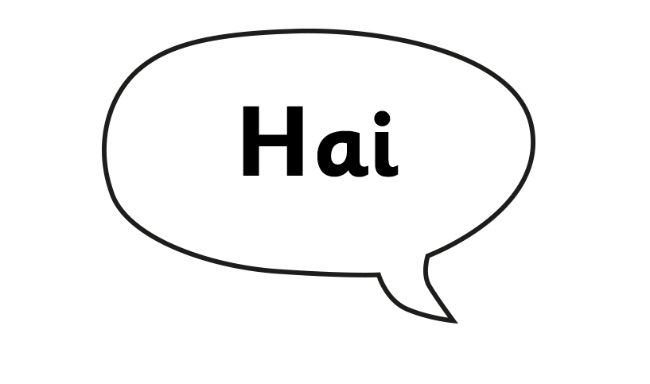
Notes:
Hi

Slide 4


Notes:
Good morning

Slide 5
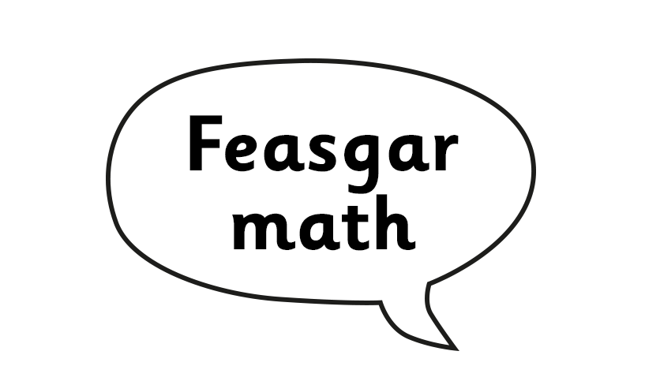

Notes:
Good afternoon/evening

Slide 6

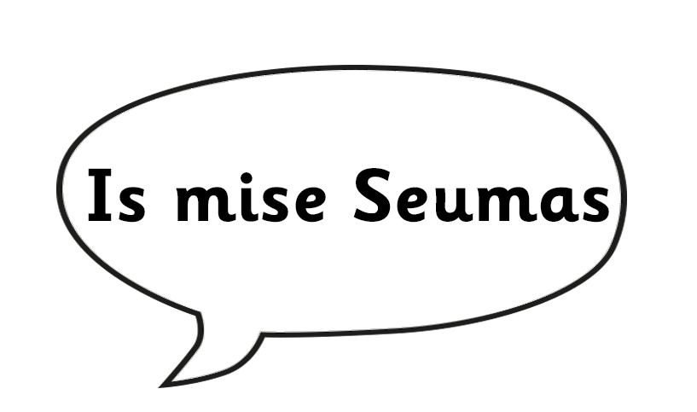
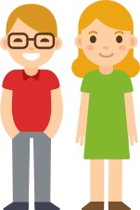
Notes:
What’s your name? I’m James.

Slide 7
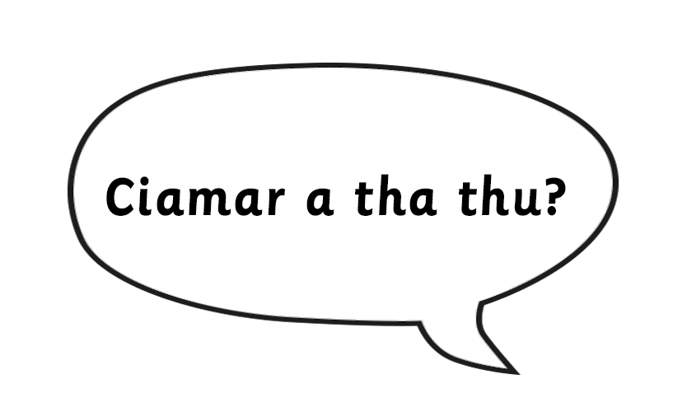
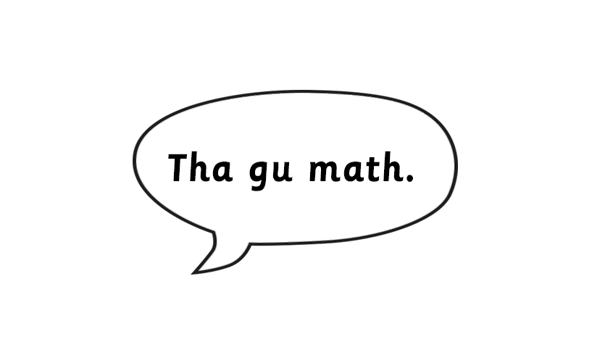
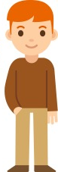
Notes:
How are you? I’m well.

Slide 8

Seo mi.
Caìt a bheil Sìne?
Notes:
Where is Sheena? Here I am.

Slide 9
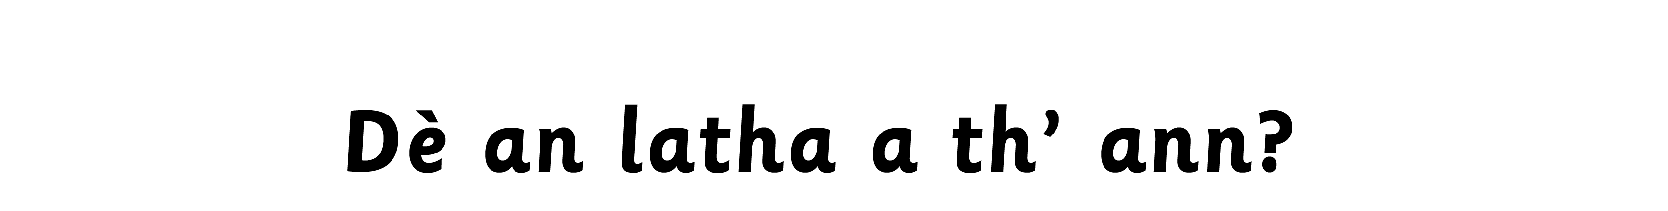
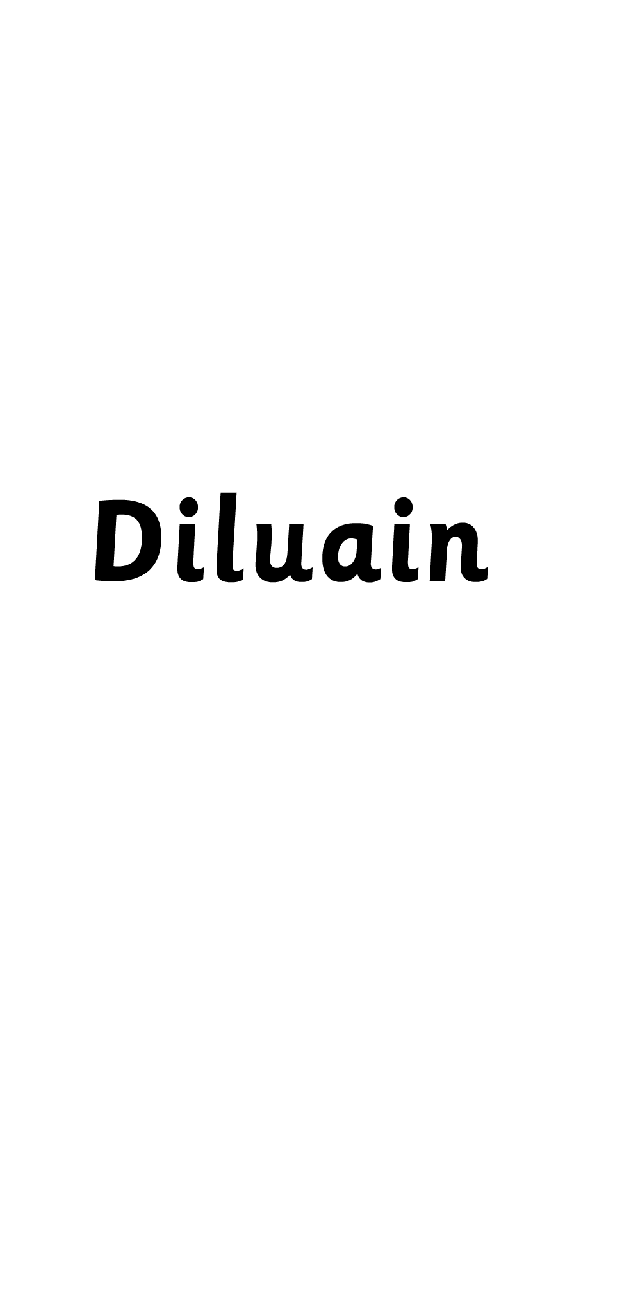
Notes:
What day is it?
Monday

Slide 10

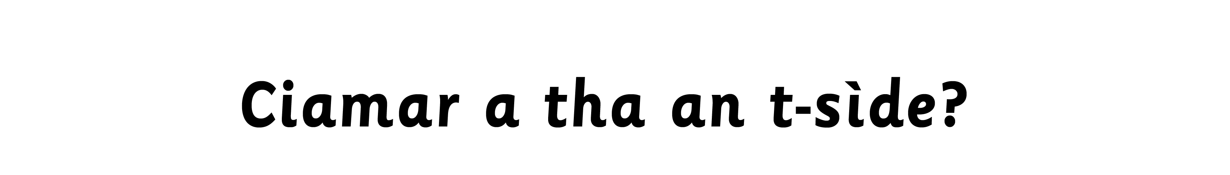



Notes:
How is the weather?

Slide 11
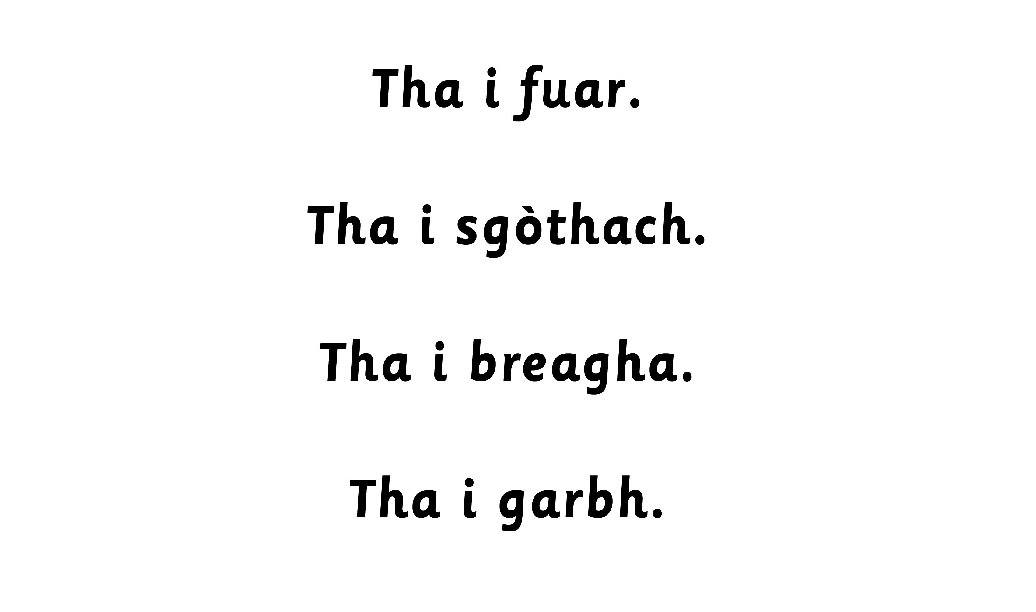
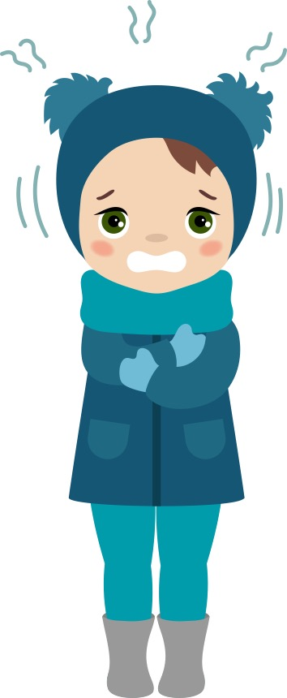
Notes:
It is cold.

Slide 12
Notes:
It is cloudy.

Slide 13
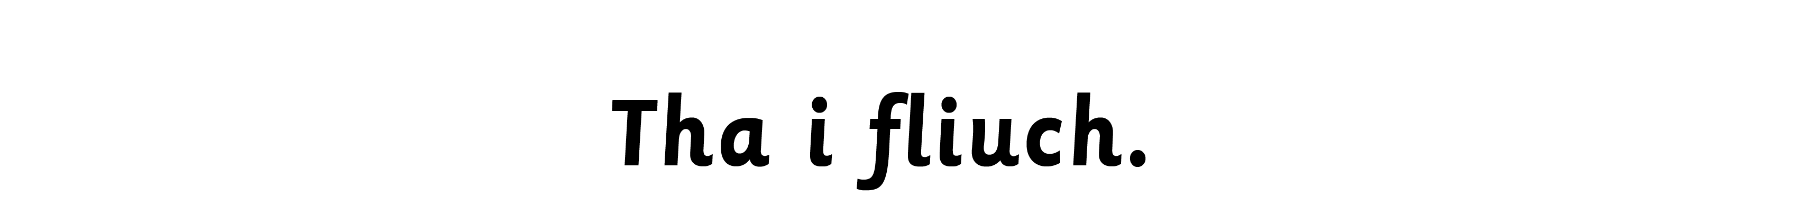
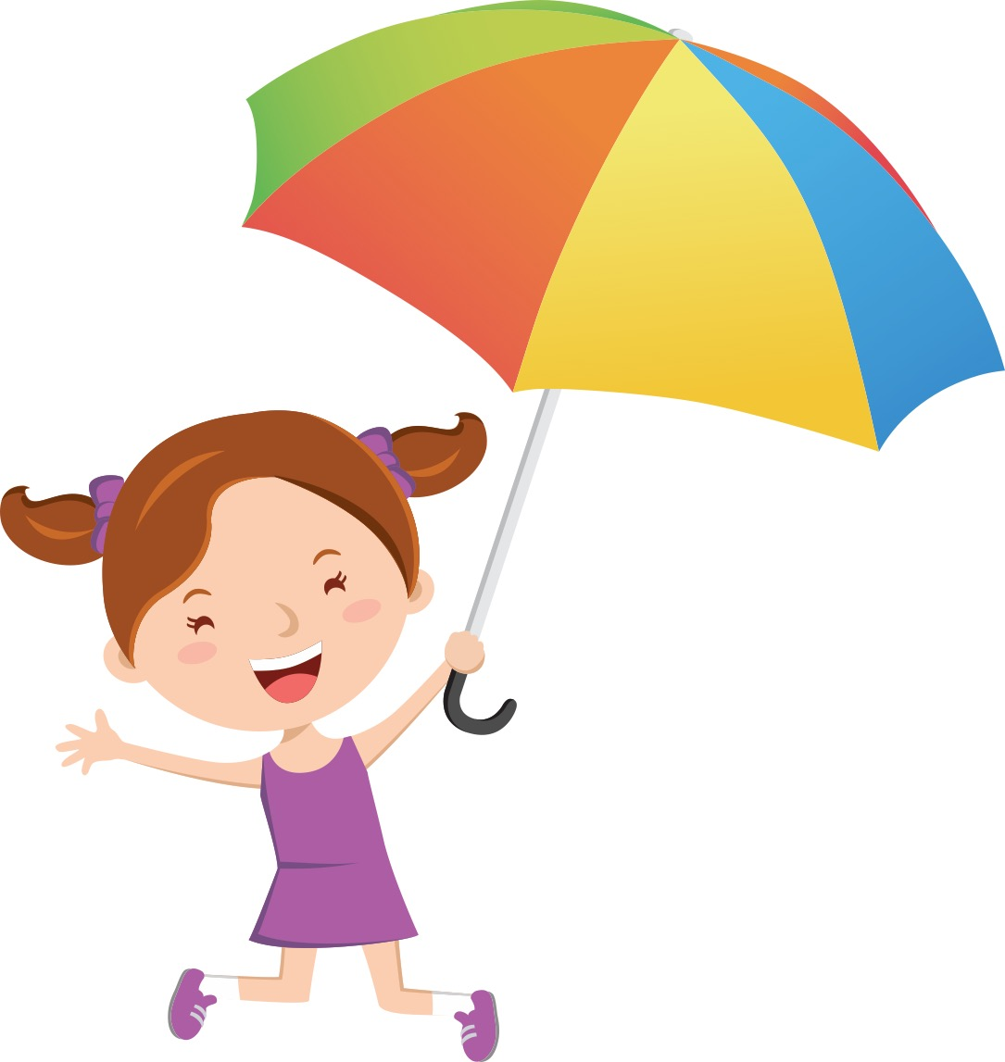
Notes:
It is wet.

Slide 14


Notes:
It is lovely.

Slide 15
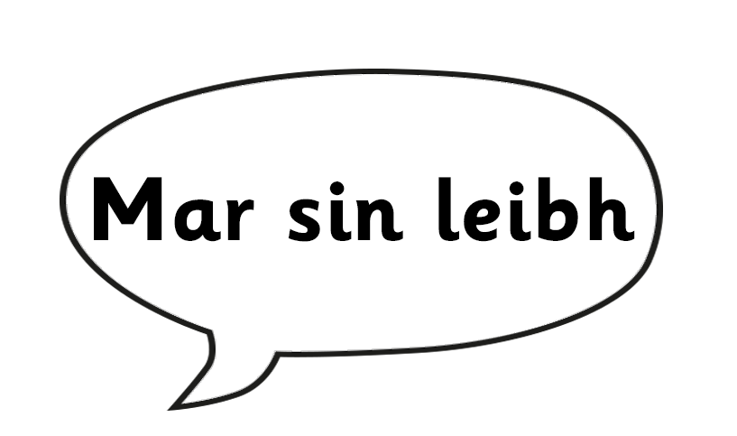

Notes:
Goodbye (plural or polite)
Goodbye (singular or informal)

Slide 16

Notes:
Goodbye. Goodbye. (Demonstrating variation in pronunciation)

